Slide 1
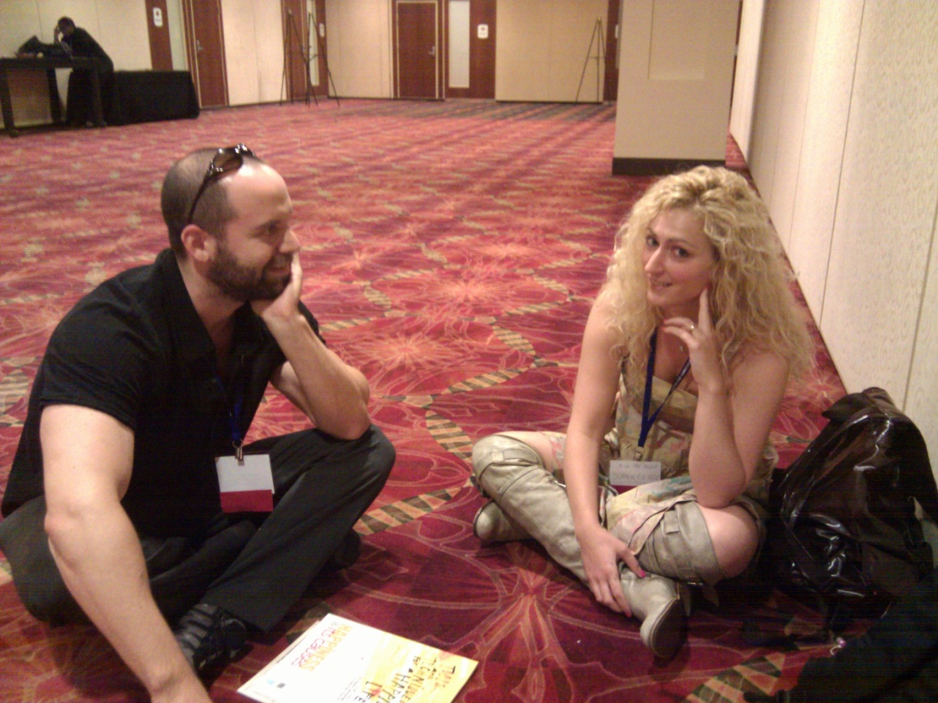

Introduction to Social Psychology
[Professor Name]
[Class and Section Number]
Notes:
Classroom Recommendations: This material could be covered in one 50 to 75-minute class period. It is intended to present overview topics in social psychology and many of the topics will be covered in greater depth in other modules. Please refer to the Lecture Framework in the Noba Instructor Manual for specific details.
Overview: You may choose to begin by having students write a 3-5 sentence summary of the module content. This should, of course, only be done if the reading was assigned prior to the class session. You may also choose to have students generate questions from the reading related to material they found confusing or interesting. For a more involved warm up activity, The Good Life.
Technical Note: These slides may contain simple click animation so that you can focus students’ attention on a particular question, a selection of text, or an image and not have them be distracted by reading ahead. You can either preview the sequence of animation by going through the slides in slideshow view, visiting the animations tab, or reviewing the slide notes. In the notes you will see a cue - (Click) – that corresponds to each animation.
You may also find hyperlinks to outside videos at various places in the slides. These hyperlinks are embedded in text and indicated by color and in the notes section.

Slide 2
Learning Objectives
1. Define social psychology and understand how it is different from other areas of psychology.
2. Understand “levels of analysis” and why this concept is important to science.
3. List at least three major areas of study in social psychology.
4. Define the “need to belong”.
Notes:
This slide outlines the learning objectives of the module.

Slide 3
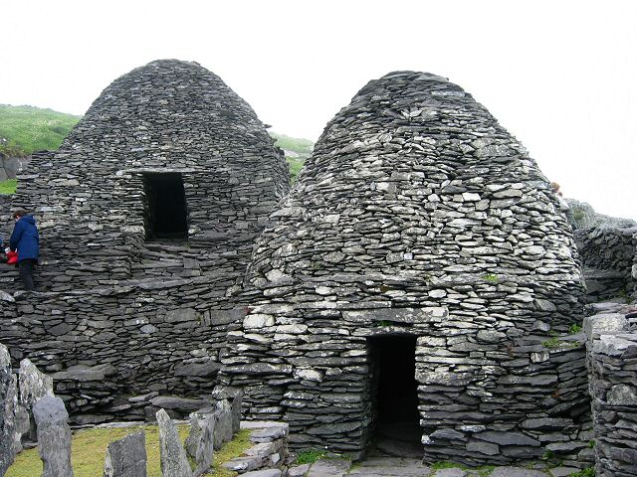
Warmup Activity: The Good Life
Write 10 things that are very important in life.
Notes:
The purpose of this slide is to facilitate an activity to get students thinking about the concept of social psychology. It is easy to generate extreme counter examples of people who live as loners, recluses and misanthropes. The picture in this slide shows cells used by Irish monks on the remote island of Skellig Michael between the years 500-1300 AD. Those examples are, however, the exception. We live in a world where people cluster together in cities, live in families, get married more often than not, and find joy in friendships. To illustrate this point, have students write down “10 things that you think are very important in life.” Next, have them count the number that fall into each category: social, material, achievement. They will have to make some private judgments. Some might consider “health” an achievement, for example, while others consider it “material.” Have the students create a fraction X/10 to indicate the number of social items.
Next, have students share their answers with a neighbor. In the subsequent large class debrief you can create a public tally by asking “how many of you had only 1 social item out of ten” (using clickers or a show of hands for responses). Then move to 2 of 10, 3 of 10 and so forth. It is possible to create a bar chart or other display on the board so that students can see the extent to which social elements are valued. Ask the students what insights they take away from this.
Note: It is possible that the students will harbor some questions or skepticism. For instance, they might suggest that a different class held in a different country would come up with different responses. This is an excellent opportunity to highlight that this is actually an example of scientific thinking: asking “how is this group different from other groups in their values or attitudes?”

Slide 4
Overview
What is social psychology?
The need to belong
Social stress
Studying social psychology
Sub-fields of psychology
Levels of analysis
Observation
What is included in Social Psychology?
Attraction
Attitudes
Peace & Conflict
Social Influence
Social Cognition
Wrap-up
Notes:
The purpose of this slide is to provide students with an overview of the material that will be covered during each portion of the lecture

Slide 5

What is Social Psychology?
The branch of psychological
science that is mainly concerned
with understanding how the
presence of others affects our
thoughts, feelings, and behaviors.
Notes:
On this slide the instructor can introduce the definition of social psychology. To help students understand why the study of social psychology is so important, the instructor can point out the “need to belong” as a universal psychological need. To illustrate this point, the instructor might choose to challenge students to:
Generate an example of someone who does not have the need to belong (students sometimes mention monks or similar aesthetics but in nearly all cases these people are part of formal religious orders bound together by explicit rules and rituals. They might also mention the rare instance of recluses. While it is true that there are rare cases of people who live in isolation there is little evidence that these people function well or enjoy high well-being).
Generate an example of a human invention or work that did not require more than one person (typically, even in the cases of individual authorship or invention people need others to help manufacture the work or its parts, or to distribute the work).

Slide 6
What is Social Psychology?
LIFE EVENT | VALUE
1. Death of Spouse | 100
2. Divorce | 73
3. Marital Separation | 65
4. Detention/Jail | 63
5. Death of Close Family Member | 63
6. Major Injury/Illness | 53
7. Marriage | 50
8. Fired from Work | 47
9. Marital Reconciliation | 45
10. Retirement | 45
Adapted from the Holmes-Rahe Life Stress Inventory
Notes:
Here, the instructor introduces the idea that humans have a need to belong. The graphic above is adapted from the Holmes-Rahe Life Stress Inventory. Each major life change event is associated with a stress value. The top 10 most stressful events are listed.
Have students break into small groups and count how many of these 10 are evidence of the need for social relationships. Students might disagree in their specific number. Some will see “fired from work” as having a social dimension (someone did the firing!) while others will make the case that “fired from work” is not primarily a social stressor (being unemployed is primarily stressful because of the lack of income security and the shift in personal identity). Regardless of the specific number the take home message of this discussion will almost certainly be that many of the most stressful life events involve being disconnected from others in one way or another. This is evidence of the need to connect.
Note that not all possible life events are listed here. Notable exceptions include “death of a child” and “crime victim”
Reference:
Holmes, T. H., & Rahe, R. H. (1967). The social readjustment rating scale. Journal of Psychosomatic Research, 11(2), 213-218.

Slide 7
Overview
What is social psychology?
The need to belong
Social stress
Studying social psychology
Sub-fields of psychology
Levels of analysis
Observation
What is included in Social Psychology?
Attraction
Attitudes
Peace & Conflict
Social Influence
Social Cognition
Wrap-up
Notes:
The purpose of this slide is to provide students with an overview of the material that will be covered during the lecture

Slide 8
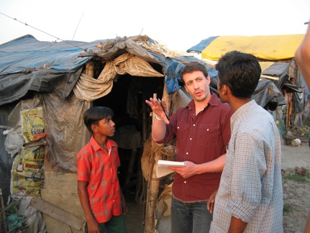
Studying Social Psychology
Notes:
Here, instructors highlight the fact that social psychology is a science. It is rooted in observation of interesting or confusing social phenomena and attempts to gain a better understanding by employing the scientific method. It is not, at heart, a political mode of inquiry even though the application of research findings may have political or social impact.
Discussion question:
--What topics would you include in the science of social psychology? Which might you exclude?

Slide 9
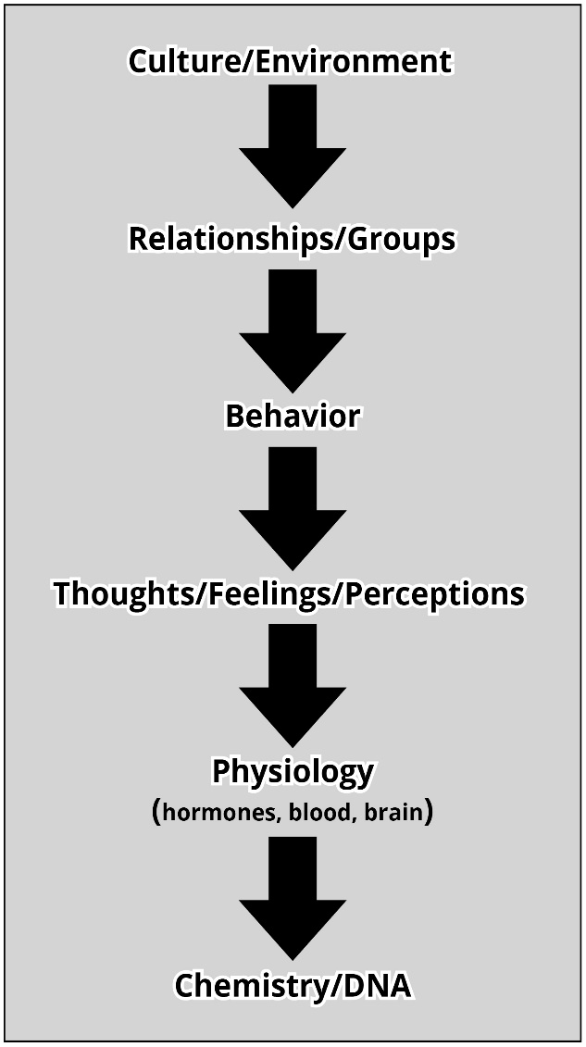
Studying Social Psychology
Levels of Analysis
Notes:
Here, instructors introduce the concept of “levels of analysis” in research. Many students find this concept to be revelatory. You may choose to ensconce the concept in a real world example. For instance:
“Imagine you and your best friend were driving down the road. You are driving slightly over the speed limit when you see a police car parked by the side of the road using radar to ticket speeders. Apply each level of analysis of research to this event.”
Example responses
Culture: Local standards differ for what speeds are deemed safe, for the amount of fines, and for how aggressively speed limits are enforced
Relationships: The presence of the passenger might have an effect (such as pointing out the police or distracting the driver)
Behavior: The driver’s response (such as slowing down)
Thoughts/Feelings: The driver’s interpretation of the event (feeling guilty, feeling relieved, etc)
Physiology: Sweating, increased heart rate and blood pressure, release of cortisol or adrenaline
DNA: It would be interesting to consider if there are possible genetic influences on impulse control which might contribute to the driver’s speeding behavior.
NOTE: You can conduct this activity as a reflection, with each student writing his or her own ideas; or as a partner or small groups exercise. If you choose to structure this as small group discussions make certain to debrief group ideas with the class as a whole. This will give you the opportunity to highlight possible agreements and disagreements between groups.

Slide 10

Studying Social Psychology
Observation
Notes:
Because social psychology is focused, in part but not in whole, on interactions and other group settings, this area of psychology lends itself to observation as a means of study. Unlike self-report, lab studies, and even field experiments, observation has the advantage of being entirely naturalistic. Here, you can engage students in the idea of social psychology research by pointing out that observation comes naturally. That, in fact, we all act as amateur social psychologists arriving at conclusions about our own social worlds through informal observation.
Activity: What have you noticed?
Here, you can have students describe– either in written form or in pairs– what they have noticed about the social environment of this particular class as compared with their other classes. Prompt them to consider any identifiable patterns of behavior. How do the students behave and treat each other? How does the instructor interact with the group? What similarities and differences do they notice between this class and their other courses? What do they attribute those differences to? Instructor factors? Size of class? Area of study? You can use the debrief to point out that they cannot help but make on-going evaluations of interaction through observation.

Slide 11
Overview
What is social psychology?
The need to belong
Social stress
Studying social psychology
Sub-fields of psychology
Levels of analysis
Observation
What is included in Social Psychology?
Attraction
Attitudes
Peace & Conflict
Social Influence
Social Cognition
Wrap-up
Notes:
The purpose of this slide is to provide students with an overview of the material that will be covered during the lecture

Slide 12
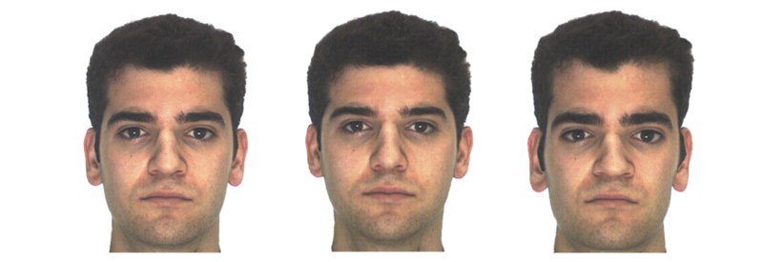
Attraction
Origins of Attractiveness
Cultural Learning: Familiarity, Ideal Types
Signals of Mate Quality: Behavior & Good Genes
Notes:
In this, and in the slides covering the subsequent 4 topics, you can point out to students that social psychology is among the most personally relevant and most easily applicable to real life of all the topics within psychology. Because this is an introductory lecture, it is an opportunity to fan the flames of interest in this topic.
Activity option # 1– Let’s Face It (5 minutes): Introduce the idea of attraction by pointing out that it is a universal phenomenon with both biological and psychological influences. Have students choose the most attractive image from among the 3 faces pictured in this slide. Which face is the best looking? You can then use clickers or a show of hands to tally the votes for each of the three. The face on the left is the actual image of a person. The face on the right is a digitally morphed version that makes the face further from average and the middle image is the most average (digitally averaged with many other faces). The middle face should get most, perhaps not all, of the votes. You can point out to students that there are biological factors (markers for good genes, genetic and mate fitness) as well as social factors (learned cultural preferences) that play into attractiveness.
Activity option # 2– Remember when(10 minutes): In this activity, students pair together and interview each other regarding a time that they felt an attraction to another person. This could be a current romantic partner, but it could also include a fleeting instant of attraction toward a stranger they passed on the street. Students should feel safe to use any example they want without concern that they need to identify the individual to whom they were attracted. The point of the exercise, instead, is to have the student describe the attraction ( eg. “I was sitting across from him on the train and I noticed his clothes, his style, his muscular arms and he smiled at me”). The “interviewer” should note any specifics regarding the attraction (eg. “Clothes, muscles, smile”). In the larger group, you can tally answers to create common categories of attraction and note any group leanings or individual differences.
Activity option # 3– Opposites attract (5-8 minutes): Here, you can point out to students the many sayings related to attraction such as “birds of a feather flock together” (people of shared interests will like one another and “opposites attract” (people of different temperaments will be attracted to one another). These two examples are, obviously, at odds with one another. This is an illustration of the many lay theories about attraction. In this activity have your students identify their own intuitions concerning attraction. Consider using the following prompts and debrief afterward:
-- What do you believe about first impressions?
-- What differences in attraction, if any, do you believe exist between people in the first year of their relationship and those in their 20th year?
-- Do you believe attraction is similar across cultures? Why or why not?

Slide 13
Attitudes
Notes:
Here, you can introduce the idea of attitudes. The most commonly covered topics in social psychology, with regards to attitudes, are: stereotyping, prejudice, and discrimination. These attitudes and behaviors are anchored in the natural psychological process of categorization generally, and in the creation of in-group and out-group categories specifically. The chart on the slide shows changing attitudes toward immigrants in the United States. You can:
--Ask students to interpret this chart.
-- Ask students to generate hypotheses to support or explain their interpretation
-- If you are not in the United States, ask your students the degree to which they believe the trends shown may or may not be reflective of attitudes in their own country. Why or why not?
-- Ask students how social research of this type might be used in the real world to guide policy or intervention that would help society function better.
Reference:
Pew Research Center. (2013). Section 1: How Generations Have Changed. Retrieved from: http://www.people-press.org/2011/11/03/section-1-how-generations-have-changed/

Slide 14

Peace & Conflict
In Group
Out Group
Group A
Group B
Group C
Notes:
One of the major areas of social psychological study is peace and conflict. You can introduce basic concepts to students here, focusing especially on in-group and out-group identity. You can explain how out-group membership is often used to understand potential threats to in-group values, resources, or safety. Because this phenomenon plays out daily in geopolitical life it can be a terrific way to show students how relevant this area of study is to real life.
Us and Them– Have students look at the “map” portrayed on the slide and have them imagine a hypothetical scenario. It shows an island next to a large landmass. The colored regions indicate cultural groups. The first red group is Group A (they speak language 1) and the Second red group is Group B (they also speak language 1 but live in a different country). The blue group is Group C (and they speak language 2). This is an interesting instance in which Group C is the majority population of their island nation. They run the government and hold most of the good jobs. Group B is the minority and they complain about a lack of fairness. However, group C sees itself as a minority since Group B is so closely culturally and economically aligned with Group A, in the neighboring country. Group C tries to protect itself and its culture through its laws and business positions. In small groups:
-- Have students offer opinions about which group (B or C) they consider the minority, and why.
-- Have students offer possible solutions to this conflict.
-- Feel free to add specific elements regarding laws (eg. Immigration and work), religion (differing religions), or resources (Group B lives in a resource rich area of the nation) that would complicate matters.
-- Have students relate major themes of this discussion to current politics.
This map is based on the Tamil and Sinhalese conflict in South India and Sri Lanka but is not meant to be an accurate map or scenario. Although this is based on a real world conflict it need not be taught in the context of actual events, dates, or people. For more information on this conflict see: https://en.wikipedia.org/wiki/Sri_Lankan_Civil_War

Slide 15
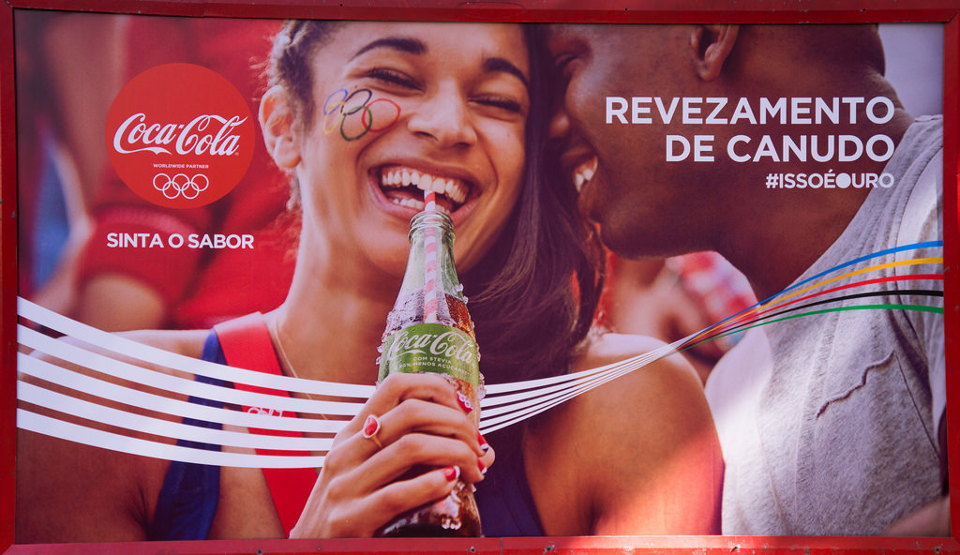
Social Influence
Persuasion
Notes:
Here, you can introduce the fascinating topic of persuasion to your students. The most commonly covered topics in introductory psychology courses are conformity and obedience. You may choose to introduce those topics here, briefly. To connect the topic of persuasion to the student’s lives consider using one or both of the following approaches:
1. Advertising– We live in a world that is saturated with ads. They appear on-line, on television, in magazines, and around town. They are everywhere. Challenge your students to consider the following:
A) Does advertising affect you? If so, how? If not, what makes you immune and why are companies spending billions on ads?
B) Have you ever described an ad to a friend? Why did you do this? What about the ad made it “share worthy?” In this context, how do you think the ad affected you?
C) Have you ever watched a political advertisement? For your or another candidate? Did you have an emotional reaction? What does this tell you about the effect of advertising?
D) Have you ever timed a purchase with an upcoming sale? How did you know this sale was going to occur? What does this tell you about advertising?
2. Debating- Everywhere in life we see conversational attempts to sway people’s thoughts, feelings and behaviors. Yelp and Amazon reviews, dinner table arguments, and political debates are all examples of ways we try to change another person’s mind. Play the 2 and a half minute clip of this CNN debate between two commentators. It is not entirely important that the students know who is being debated (US Republican Michele Bauchman) or the specifics of the policies being discussed. Instead, the students should focus on the methods of persuasion.
https://www.youtube.com/watch?v=7mN-84kj77Q
-- Which commentator do they find more compelling? Why?
--What do they notice in terms of the strategies each commentator uses to sway the audience?
(responses might include humor, smiling, agreement with the other person, predicting what their opponent will say, attacking their opponents character, etc).
-- After a brief discussion, reveal to your students that the commentators– Mary Matalin and James Carville– are married to one another. How does this affect their perception of the debate?

Slide 16
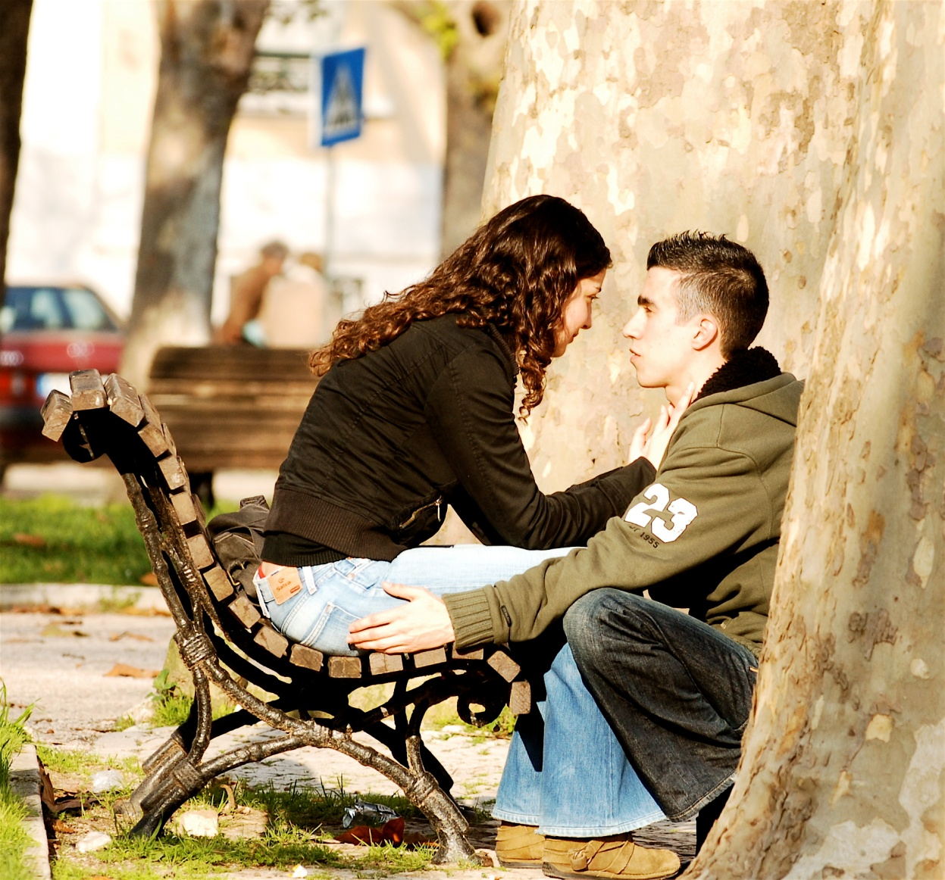
Social Cognition
Notes:
Social Cognition is the term for how we think about the social world. There are a number of topics that are commonly taught including, but not limited to, heuristics. The purpose of this slide is not to teach an entire unit on social cognition but to introduce your students to the idea that all of us think about the social world. One common way we do this is by “telling stories” in our heads based on incomplete information. For example, we attribute emotions, motivations, and even personality traits to other people using very little information. We do this with other drivers on the road, other people in line at the grocery story, people we pass while hiking– virtually everyone.
Have your students consider the image of the two people. Ask them to write down the answers these two questions and then discuss in the large group:
What is the relation of these two people to one another?
What are they doing?
Debriefing points:
Relationship agreement versus disagreement; it is likely that there will be a relatively high degree of agreement. Most people will say they are boyfriend/girlfriend, lovers or otherwise romantically involved. Some may believe they are friends. It is noteworthy that most people will NOT say that they are siblings, mother and son, parole officer and parolee, etc. Let the students indicate the information they used to arrive at their conclusions. Common sources of information include: age, dress, hand position (touching), and proximity.
Activity agreement versus disagreement; It is likely that there will be more disagreement here because the nature of their interaction is somewhat ambiguous. They may be showing affection/sharing intimacy with one another. Then again, they may be planning a bank robbery. She may be breaking up with him. The more alternative scenarios that are generated the more students should realize this important fact: we rush to closure on an explanatory story.
You can ask students to share examples of times that made a social assumption and were proven wrong, or right. Have them discuss how they think this cognitive habit helps us even though it can lead to erroneous guesses.

Slide 17

CAT: One-Minute Paper
What was the most important thing you learned during this class?
What important question remains unanswered?
Notes:
Classroom Assessment Technique (CAT): One-Minute Paper
If you are presenting the information on one class day, you might end the material about here. End your class time with a one-minute paper.
The Minute Paper tests how students are gaining knowledge, or not. The instructor ends class by asking students to write a brief response to the following questions: “What was the most important thing you learned during this class?” and “What important question remains unanswered?”
Have students briefly answer these questions in writing and turn them in. After class, assess students’ responses. At the beginning of the next class, go over any misunderstandings or relevant questions.
If you do not conclude with this Classroom Assessment Technique (CAT), it would helpful to use another CAT. It could be in the form of a:
Muddy point
One-minute paper
Background knowledge
What’s the Principle?
Defining features Matrix:
For more information on CATs click here: http://cft.vanderbilt.edu/guides-sub-pages/cats/

Slide 18
Photo Attribution
Slide 1 | Photo Credit: Mirroring Effect. Noba Project. https://creativecommons.org/licenses/by-nc-sa/4.0/deed.en_US
Slide 3 | Photo Credit: Skellig Michael's behive huts, Ireland. Right - Cell F, left - Cell E Rob Burke https://commons.wikimedia.org/wiki/File:Skellig_Michael_-_cell_E_and_F.jpg#/media/File:Skellig_Michael_-_cell_E_and_F.jpg https://creativecommons.org/licenses/by-sa/2.0/
Slide 5 | Photo Credit: Greek letter Psi Niki K https://commons.wikimedia.org/wiki/File:Psi2.png#/media/File:Psi2.png Public Domain
Slide 6 | Table Credit: Adapted from: Holmes, T. H., & Rahe, R. H. (1967). The social readjustment rating scale. Journal of Psychosomatic Research, 11(2), 213-218.
Slide 8 | Photo Credit: Social Psychology Research in Action. Noba Project. https://creativecommons.org/licenses/by-nc-sa/4.0/deed.en_US
Slide 9 | Image Credit: Levels of Analysis in Social Psychology. Noba Project. https://creativecommons.org/licenses/by-nc-sa/4.0/deed.en_US
Slide 10 | Photo Credit: Eyes Pedro Ribeiro Simões https://www.flickr.com/photos/46944516@N00/5155333138/ https://creativecommons.org/licenses/by/2.0/
Slide 12 | Image Credit: Martinez, A. M., & Benavente, R. (1998). The AR face database, CVC Tech. Report #24.
Slide 13 | Image Credit: Created using information from: Pew Research Center. (2013). Section 1: How Generations Have Changed. Retrieved from: http://www.people-press.org/2011/11/03/section-1-how-generations-have-changed/
Slide 14 | Image Credit: Created using information from: Wikipedia. (2016). Sri Lankan Civil War. Retrieved from: https://en.wikipedia.org/wiki/Sri_Lankan_Civil_War
Notes:
Photo Attribution Slide

Slide 19
Photo Attribution
Slide 15 | Photo Credit: Coca-Cola-Rio-de-Janeiro-Olympics-2016---Straw-Relay-Coca-Cola-Green-Debut---news-stand José Roitberg https://www.flickr.com/photos/8136098@N05/28092343240 https://creativecommons.org/licenses/by-nc-nd/2.0/
Slide 16 | Photo Credit: Couple in love Pedro Ribeiro Simões https://www.flickr.com/photos/pedrosimoes7/347889430 https://creativecommons.org/licenses/by/2.0/
Slide 17 | Photo Credit: Photo Credit: Illustrated silhouette of a black cat nehtaeh79 http://www.freestockphotos.biz/stockphoto/16624 http://creativecommons.org/publicdomain/zero/1.0/
Notes:
Photo Attribution Slide

